Slide 1

Financial Analytics

Slide 2
Objectives
Top 10 Companies with highest Market Capital
Top 10 Companies with highest Quarterly Sales
Bottom 10 Companies with lowest Market Capital
Bottom 10 Companies with lowest Quarterly Sales

Slide 3
The Process
Q1
Data Collection
Q2
Data Cleaning
Q3
Data Analysis
Q4
Insights

Slide 4

Data Collection
The Data has been collected in the form of a CSV file named “financial_data_analysis.csv”.
The CSV file has the data (Market capital and Quarterly Sales) of top 500 companies.
4

Slide 5

Data Cleaning
Removed the S. No. column as it is not required for analysis.
Some values of the column ‘Sales Qtr. - Crore’ are written on the adjacent column. I used Paste Special dialogue box and check the ‘skip blanks’ option to move those values to its original column.
Then I used python to deal with NaN values and removed the outliers.

Slide 6
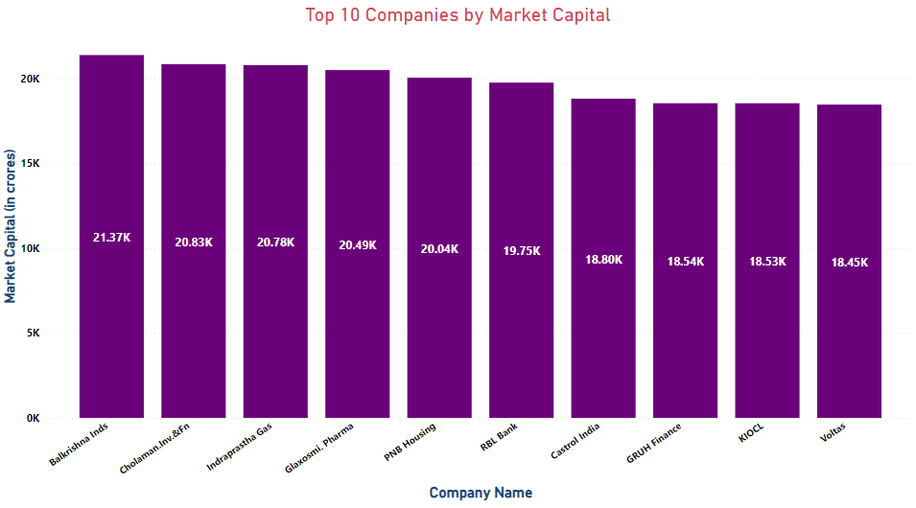
Data Analysis
Balkrishna Inds has the highest Market Capital at 21.37K Crores

Slide 7
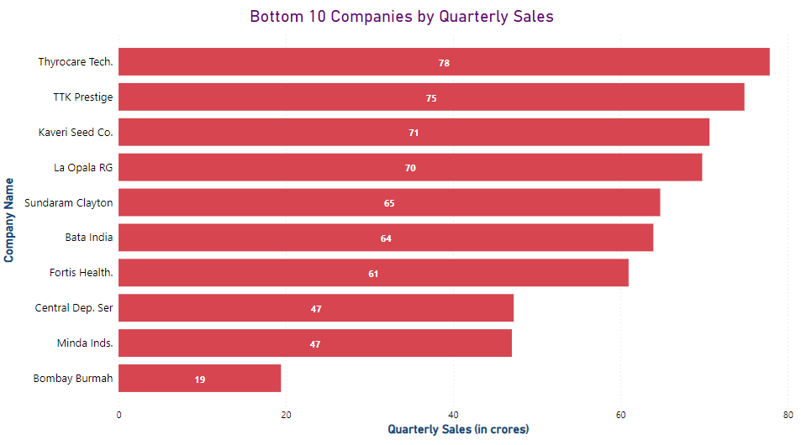
Data Analysis
Bombay Burmah has the lowest Quarterly Sales at 19 Crores only

Slide 8
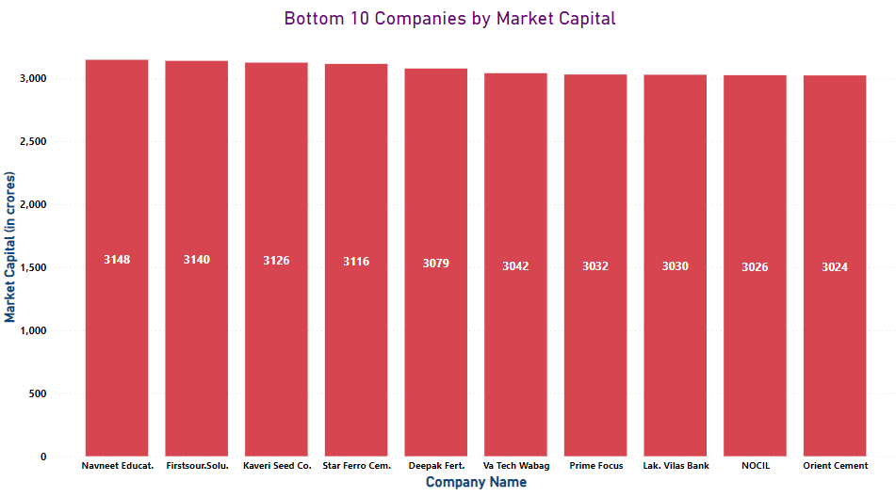
Data Analysis
Orient Cement has the lowest Market Capital at 3024 Crores

Slide 9
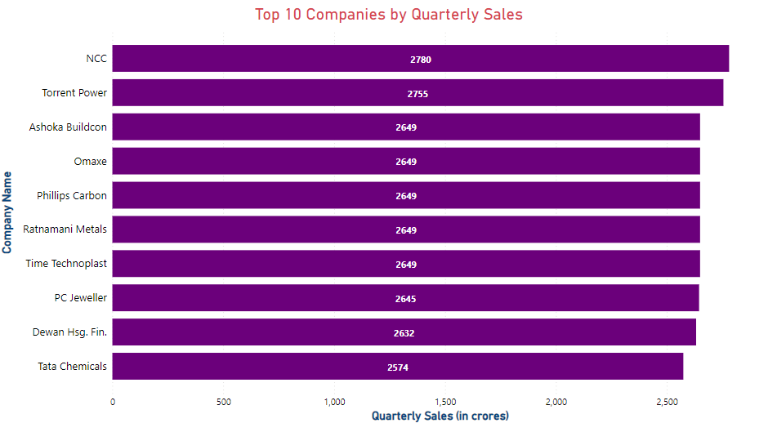
Data Analysis
NCC has the highest Quarterly Sales at 2780 Crores

Slide 10

Insights
Balkrishna Industries and Cholaman Investment and Finance has the Highest Market Capital at 21.37K Crores and 20.83K Crores respectively which is 606.6 % more than Orient Cement which has the lowest Market Capital at 3024 Crores.
NCC has the Highest Quarterly Sales at 2780 Crores which is 14531.5 % more than Bombay Burmah which has the lowest Quarterly Sales of 19 Crores.

Slide 11

THANK YOU
@Vishal Morya

